Slide 1
Javascript, Canvas in JQuery
Milan Ojsteršek

Slide 2
Javascript example
<!DOCTYPE html>
<html>
<body>
<p id="demo">Click the button to change the text in this paragraph.</p>
<button onclick="myFunction()">Try it</button>
<script>
function myFunction() {
document.getElementById("demo").innerHTML = "Hello World";
}
</script>
</body>
</html>

Slide 3
Features of Javascript
Javascript has C++ „like“ syntax
Javascript is dynamic typing language – see also Javascript conversion
Javasript reacts to events
Javascript is object oriented language
  JavaScript Can Change HTML Content
  JavaScript Can Change HTML Attributes
  JavaScript Can Change HTML Styles (CSS)
JSON is a format for storing and transporting data ( read also about JSONP)

Slide 4
Input and output in Javascript
Input in Javascript
  window.prompt, Javascript conversion
  window.confirm
  input in HTML and form validation
Output in Javascript
  document.write
  window.alert
  console.log
  writing into HTML

Slide 5
Javascript basics
<button onclick="myFunction()">Try it</button>
<p id="demo"></p>
<script>
function myFunction() {
var text = ""
var i = 0;
do {
text += "<br>The number is " + i;
i++;
}
while (i < 5);
document.getElementById("demo").innerHTML = text;
}
</script>
Variables Operators
Statements
(if, switch, for, while,
break)
Functions ( scope )
Objects

Slide 6
Predefined objects
_x000b_Global
String (reference)
Number (reference)
Math (reference)
Date (reference)
Array (reference)
Boolean
Error (reference)
RegExp (reference)
<button onclick="myFunction()">Try it</button>
<p id="demo"></p>
<script>
function myFunction() {
var x = 10;
var y = 20;
var a = eval("x * y") + "<br>";
var b = eval("2 + 2") + "<br>";
var c = eval("x + 17") + "<br>";
c=c+eval("alert('Be carefull');");
var res = a + b + c;
document.getElementById("demo").innerHTML = res;
}
</script>

Slide 7
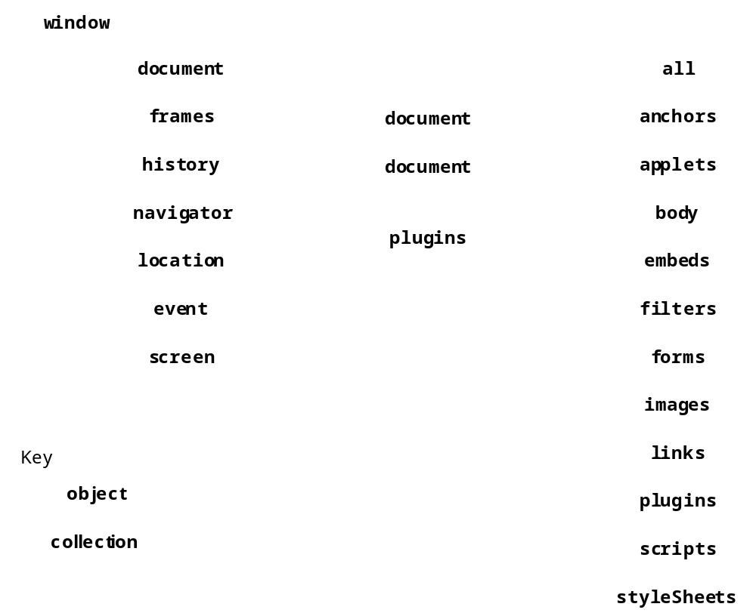
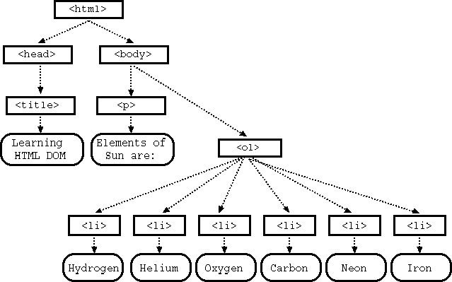
DOM object model

Slide 8
The Browser object model
Window
Screen
Location
History
Navigator
Cookies
Timing

Slide 9
HTML DOM objects
document
  document.getElementById()
  document.getElementsByClassName()
  document.getElementsByName()
  document.getElementsByTagName()
HTML elements
HTML attributes
HTML events
CSS styles

Slide 10
HTML CANVAS
Drawing in CANVAS (rectangle, line, circle, gradients, text, images).
CANVAS reference
CANVAS clock example
CANVAS game example
HTML Canvas element:
<canvas id="myCanvas" width="200" height="100"style="border:1px solid #000000;"></canvas>
Drawing with Canvas:
1. Find the Canvas Element:
var canvas = document.getElementById("myCanvas");
2. Create a Drawing Object:
var ctx = canvas.getContext("2d");
3. Draw on the Canvas:
ctx.fillStyle = "#FF0000";
ctx.fillRect(0,0,150,75);

Slide 11
jQuery
<script src="https://ajax.googleapis.com/ajax/libs/jquery/3.2.1/jquery.min.js"></script>
<script>
$(document).ready(function(){
$("p").click(function(){
$(this).hide();
});
});
</script>

Slide 12
JQuery selectors
$("#test")
$(".test")
$("p.intro")
$("p:first")
$("ul li:first")
$("[href]")
$("a[target='_blank']")

Slide 13
jQuery Event Methods
$("p").click(function(){
alert("The paragraph was clicked.");
});
$("p").hover(function(){
$(this).css("background-color", "yellow");
}, function(){
$(this).css("background-color", "pink");
});
jQuery Events reference

Slide 14
jQuery Effects
Hide and show elements:
$("#hide").click(function(){_x000b_ $("p").hide();_x000b_});_x000b__x000b_$("#show").click(function(){_x000b_ $("p").show();_x000b_});
Fade in
$("button").click(function(){_x000b_ $("#div1").fadeIn();_x000b_ $("#div2").fadeIn("slow");_x000b_ $("#div3").fadeIn(3000);_x000b_});

Slide 15
Callback
$("button").click(function(){
$("p").hide("slow",function(){
alert("The paragraph is now hidden");
});
});

Slide 16
Chaining
$(document).ready(function()
{
$("button").click(function(){
$("#p1").css("color","red").slideUp(2000).slideDown(2000);
});
});

Slide 17
jQuery - Set Content and Attribute
$("#btn1").click(function(){
$("#test1").text("Hello");
});
$("#btn2").click(function(){
$("#test2").html("<b>Hello!</b>");
});
$("#btn3").click(function(){
$("#test3").val(„Hello");
});

Slide 18
jQuery - Add Elements
$("p").append("Some appended text.");
$("p").prepend("Some prepended text.");
$("img").after("Some text after");
$("img").before("Some text before");

Slide 19
jQuery - Get and Set CSS Classes
$("p").css("background-color","yellow");
$("button").click(function(){
$("#div1").addClass("important blue");
});
$("button").click(function(){
$("h1,h2,p").removeClass("blue");
});

Slide 20
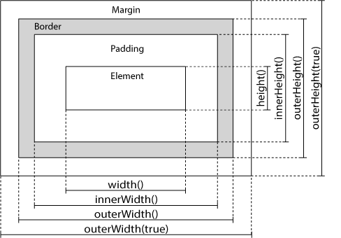
jQuery - Dimensions
$("button").click(function(){
$("#div1").width(500).height(500);
});

Slide 21
Traversing the DOM
$(document).ready(function(){
$("ul").children().css({"color":"red","border":"2px solid red"});
});
$(document).ready(function(){
$("span").parent();
});
$(document).ready(function(){
$("h2").siblings("p");
});

Slide 22
jQuery - Filters
$(document).ready(function(){
$("div p").first().css("background-color","yellow");
});
$(document).ready(function(){
$("p").eq(1);
});
$(document).ready(function(){
$("p").filter(".intro");
});

Slide 23
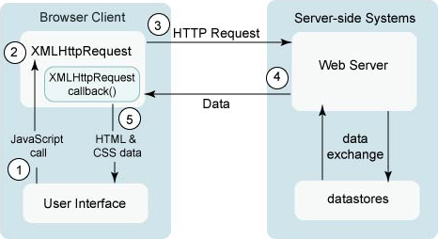
AJAX (Asynchronous JavaScript And XML)

Slide 24
AJAX
AJAX in PHP
  XMLHTTP object
  AJAX request
  AJAX response
AJAX in jQuery
  load
  get/post

Slide 25
Bootstrap
<!DOCTYPE html>
<html lang="en">
<head>
<title>Bootstrap Example</title>
<meta charset="utf-8">
<meta name="viewport" content="width=device-width, initial-scale=1">
<link rel="stylesheet"
href="https://maxcdn.bootstrapcdn.com/bootstrap/3.3.7/css/bootstrap.min.css">
<script
src="https://ajax.googleapis.com/ajax/libs/jquery/3.2.1/jquery.min.js">
</script>
<script
src="https://maxcdn.bootstrapcdn.com/bootstrap/3.3.7/js/bootstrap.min.js">
</script>
</head>
<body>
<div class="container-fluid">
<h1>Hello World!</h1>
<p>Resize the browser window to see the effect.</p>
<p>The columns will automatically stack on top of each other when the screen is less than 768px wide.</p>
<div class="row">
<div class="col-sm-4" style="background- color:lavender;">.col-sm-4</div>
<div class="col-sm-4" style="background- color:lavenderblush;">.col-sm-4</div>
<div class="col-sm-4" style="background- color:lavender;">.col-sm-4</div>
</div>
</div>
</body>
</html>

Slide 26
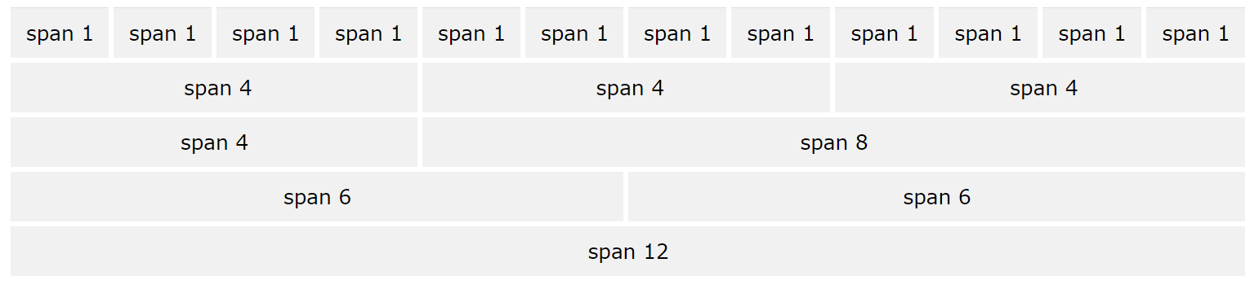
Bootstrap grid
Bootstrap's grid system allows up to 12 columns across the page.
If you do not want to use all 12 columns individually, you can group the columns together to create wider columns
The Bootstrap grid system has four classes:
xs (for phones - screens less than 768px wide)
sm (for tablets - screens equal to or greater than 768px wide)
md (for small laptops - screens equal to or greater than 992px wide)
lg (for laptops and desktops - screens equal to or greater than 1200px wide)
The classes above can be combined to create more dynamic and flexible layouts.
<div class="row">
<div class="col-sm-4">.col-sm-4</div>
<div class="col-sm-8">.col-sm-8</div>
</div>

Slide 27
Bootstrap reference
Bootstrap CSS Ref
  CSS All Classes, CSS Typography, CSS Buttons, CSS Forms,
  CSS Helpers, CSS Images, CSS Tables, CSS Dropdowns, CSS Navs, Glyphicons
Bootstrap JS Ref
  JS Affix, JS Alert, JS Button, JS Carousel, JS Collapse, JS Dropdown, JS Modal, JS Popover, JS Scrollspy, JS Tab, JS Tooltip.

